Slide 1


Chapter 7
Multimedia Networking
Computer Networking: A Top Down Approach
6th edition
Jim Kurose, Keith Ross
Addison-Wesley
March 2012
A note on the use of these ppt slides:
We’re making these slides freely available to all (faculty, students, readers). They’re in PowerPoint form so you see the animations; and can add, modify, and delete slides (including this one) and slide content to suit your needs. They obviously represent a lot of work on our part. In return for use, we only ask the following:
If you use these slides (e.g., in a class) that you mention their source (after all, we’d like people to use our book!)
If you post any slides on a www site, that you note that they are adapted from (or perhaps identical to) our slides, and note our copyright of this material.
Thanks and enjoy! JFK/KWR
All material copyright 1996-2012
J.F Kurose and K.W. Ross, All Rights Reserved
Multmedia Networking
7-<number>

Slide 2
Multimedia networking: outline
7.1 multimedia networking applications
7.2 streaming stored video
7.3 voice-over-IP
7.4 protocols for real-time conversational applications
7.5 network support for multimedia
Multmedia Networking
7-<number>

Slide 3
Multimedia networking: outline
7.1 multimedia networking applications
7.2 streaming stored video
7.3 voice-over-IP
7.4 protocols for real-time conversational applications
7.5 network support for multimedia
Multmedia Networking
7-<number>

Slide 4
Multimedia: audio
analog audio signal sampled at constant rate
  telephone: 8,000 samples/sec
  CD music: 44,100 samples/sec
each sample quantized, i.e., rounded
  e.g., 2⁸=256 possible quantized values
  each quantized value represented by bits, e.g., 8 bits for 256 values
quantization error
quantized value of
analog value
analog
signal
audio signal amplitude
time
sampling rate
(N sample/sec)
Multmedia Networking
7-<number>

Slide 5
Multimedia: audio
example: 8,000 samples/sec, 256 quantized values: 64,000 bps
receiver converts bits back to analog signal:
  some quality reduction
example rates
CD: 1.411 Mbps
MP3: 96, 128, 160 kbps
Internet telephony: 5.3 kbps and up
quantization error
quantized value of
analog value
analog
signal
audio signal amplitude
time
sampling rate
(N sample/sec)
Multmedia Networking
7-<number>

Slide 6

Multimedia: video
spatial coding example: instead of sending N values of same color (all purple), send only two values: color value (purple) and number of repeated values (N)
video: sequence of images displayed at constant rate
  e.g. 24 images/sec
digital image: array of pixels
  each pixel represented by bits
coding: use redundancy within and between images to decrease # bits used to encode image
  spatial (within image)
  temporal (from one image to next)
……………………...…
……………………...…
frame i
temporal coding example: instead of sending complete frame at i+1, send only differences from frame i
frame i+1
Multmedia Networking
7-<number>

Slide 7
Multimedia: video
spatial coding example: instead of sending N values of same color (all purple), send only two values: color value (purple) and number of repeated values (N)
CBR: (constant bit rate): video encoding rate fixed
VBR: (variable bit rate): video encoding rate changes as amount of spatial, temporal coding changes
examples:
  MPEG 1 (CD-ROM) 1.5 Mbps
  MPEG2 (DVD) 3-6 Mbps
  MPEG4 (often used in Internet, < 1 Mbps)
……………………...…
……………………...…
frame i
temporal coding example: instead of sending complete frame at i+1, send only differences from frame i
frame i+1
Multmedia Networking
7-<number>

Slide 8
Multimedia networking: 3 application types
streaming, stored audio, video
  streaming: can begin playout before downloading entire file
  stored (at server): can transmit faster than audio/video will be rendered (implies storing/buffering at client)
  e.g., YouTube, Netflix, Hulu
conversational voice/video over IP
  interactive nature of human-to-human conversation limits delay tolerance
  e.g., Skype
streaming live audio, video
  e.g., live sporting event (futbol)
Multmedia Networking
7-<number>

Slide 9
Multimedia networking: outline
7.1 multimedia networking applications
7.2 streaming stored video
7.3 voice-over-IP
7.4 protocols for real-time conversational applications
7.5 network support for multimedia
Multmedia Networking
7-<number>

Slide 10


Streaming stored video:
Cumulative data
2. video
sent
video
recorded (e.g., 30 frames/sec)
3. video received,
played out at client
(30 frames/sec)
network delay
(fixed in this example)
time
streaming: at this time, client
playing out early part of video,
while server still sending later
part of video
Multmedia Networking
7-<number>

Slide 11
Streaming stored video: challenges
continuous playout constraint: once client playout begins, playback must match original timing
  … but network delays are variable (jitter), so will need client-side buffer to match playout requirements
other challenges:
  client interactivity: pause, fast-forward, rewind, jump through video
  video packets may be lost, retransmitted
Multmedia Networking
7-<number>

Slide 12
Streaming stored video: revisted
constant bit
rate video
transmission
client video
reception
constant bit
rate video
playout at client
Cumulative data
variable
network
delay
buffered
video
client playout
delay
time
client-side buffering and playout delay: compensate for network-added delay, delay jitter
Multmedia Networking
7-<number>

Slide 13

Client-side buffering, playout
buffer fill level, Q(t)
variable fill
rate, x(t)
playout rate,
e.g., CBR r
video server
client application
buffer, size B
client
Multmedia Networking
7-<number>

Slide 14
Client-side buffering, playout
buffer fill level, Q(t)
variable fill
rate, x(t)
playout rate,
e.g., CBR r
_x0013_
video server
client application
buffer, size B
client
1. Initial fill of buffer until playout begins at t_{p}
2. playout begins at t_{p,}
3. buffer fill level varies over time as fill rate x(t) varies and playout rate r is constant
Multmedia Networking
7-<number>

Slide 15
Client-side buffering, playout
buffer fill level, Q(t)
variable fill
rate, x(t)
playout rate,
e.g., CBR r
video server
client application
buffer, size B
playout buffering: average fill rate (x), playout rate (r):
x < r: buffer eventually empties (causing freezing of video playout until buffer again fills)
x > r: buffer will not empty, provided initial playout delay is large enough to absorb variability in x(t)
  initial playout delay tradeoff: buffer starvation less likely with larger delay, but larger delay until user begins watching
Multmedia Networking
7-<number>

Slide 16
Streaming multimedia: UDP
server sends at rate appropriate for client
  often: send rate = encoding rate = constant rate
  transmission rate can be oblivious to congestion levels
short playout delay (2-5 seconds) to remove network jitter
error recovery: application-level, timeipermitting
RTP [RFC 2326]: multimedia payload types
UDP may not go through firewalls
Multmedia Networking
7-<number>

Slide 17
Streaming multimedia: HTTP
multimedia file retrieved via HTTP GET
send at maximum possible rate under TCP
fill rate fluctuates due to TCP congestion control, retransmissions (in-order delivery)
larger playout delay: smooth TCP delivery rate
HTTP/TCP passes more easily through firewalls
_x0013_
variable rate, x(t)
_x0013_
_x0013_
video
file
TCP send buffer
TCP receive buffer
application playout buffer
server
client
Multmedia Networking
7-<number>

Slide 18
Streaming multimedia: DASH
DASH: Dynamic, Adaptive Streaming over HTTP
server:
  divides video file into multiple chunks
  each chunk stored, encoded at different rates
  manifest file: provides URLs for different chunks
client:
  periodically measures server-to-client bandwidth
  consulting manifest, requests one chunk at a time
    chooses maximum coding rate sustainable given current bandwidth
    can choose different coding rates at different points in time (depending on available bandwidth at time)
Multmedia Networking
7-<number>

Slide 19
Streaming multimedia: DASH
DASH: Dynamic, Adaptive Streaming over HTTP
“intelligence” at client: client determines
  when to request chunk (so that buffer starvation, or overflow does not occur)
  what encoding rate to request (higher quality when more bandwidth available)
  where to request chunk (can request from URL server that is “close” to client or has high available bandwidth)
Multmedia Networking
7-<number>

Slide 20
Content distribution networks
challenge: how to stream content (selected from millions of videos) to hundreds of thousands of simultaneous users?
option 1: single, large “mega-server”
  single point of failure
  point of network congestion
  long path to distant clients
  multiple copies of video sent over outgoing link
….quite simply: this solution doesn’t scale
Multmedia Networking
7-<number>

Slide 21
Content distribution networks
challenge: how to stream content (selected from millions of videos) to hundreds of thousands of simultaneous users?
option 2: store/serve multiple copies of videos at multiple geographically distributed sites (CDN)
  enter deep: push CDN servers deep into many access networks
    close to users
    used by Akamai, 1700 locations
  bring home: smaller number (10’s) of larger clusters in POPs near (but not within) access networks
    used by Limelight
Multmedia Networking
7-<number>

Slide 22

CDN: “simple” content access scenario
Bob (client) requests video http://netcinema.com/6Y7B23V
video stored in CDN at http://KingCDN.com/NetC6y&B23V
1. Bob gets URL for for video http://netcinema.com/6Y7B23V
from netcinema.com
web page
2. resolve http://netcinema.com/6Y7B23V
via Bob’s local DNS
1
2
6. request video from
KINGCDN server,
streamed via HTTP
5
4&5. Resolve
http://KingCDN.com/NetC6y&B23
via KingCDN’s authoritative DNS, which returns IP address of KIingCDN
server with video
netcinema.com
3. netcinema’s DNS returns URL
http://KingCDN.com/NetC6y&B23V
4
3
netcinema’s
authorative DNS
KingCDN.com
KingCDN
authoritative DNS
Multmedia Networking
7-<number>

Slide 23
CDN cluster selection strategy
challenge: how does CDN DNS select “good” CDN node to stream to client
  pick CDN node geographically closest to client
  pick CDN node with shortest delay (or min # hops) to client (CDN nodes periodically ping access ISPs, reporting results to CDN DNS)
  IP anycast
alternative: let client decide - give client a list of several CDN servers
  client pings servers, picks “best”
  Netflix approach
Multmedia Networking
7-<number>

Slide 24
Case study: Netflix
30% downstream US traffic in 2011
owns very little infrastructure, uses 3rd party services:
  own registration, payment servers
  Amazon (3rd party) cloud services:
    Netflix uploads studio master to Amazon cloud
    create multiple version of movie (different endodings) in cloud
    upload versions from cloud to CDNs
    Cloud hosts Netflix web pages for user browsing
  three 3rd party CDNs host/stream Netflix content: Akamai, Limelight, Level-3
Multmedia Networking
7-<number>

Slide 25

Case study: Netflix
upload copies of multiple versions of video to CDNs
Amazon cloud
Akamai CDN
Netflix registration,
accounting servers
3. Manifest file
returned for
requested video
2. Bob browses
Netflix video
Limelight CDN
2
3
1
1. Bob manages Netflix account
Level-3 CDN
4. DASH streaming
Multmedia Networking
7-<number>

Slide 26
Multimedia networking: outline
7.1 multimedia networking applications
7.2 streaming stored video
7.3 voice-over-IP
7.4 protocols for real-time conversational applications
7.5 network support for multimedia
Multmedia Networking
7-<number>

Slide 27
Voice-over-IP (VoIP)
VoIP end-end-delay requirement: needed to maintain “conversational” aspect
  higher delays noticeable, impair interactivity
  < 150 msec: good
  > 400 msec bad
  includes application-level (packetization,playout), network delays
session initialization: how does callee advertise IP address, port number, encoding algorithms?
value-added services: call forwarding, screening, recording
emergency services: 911
Multmedia Networking
7-<number>

Slide 28
VoIP characteristics
speaker’s audio: alternating talk spurts, silent periods.
  64 kbps during talk spurt
  pkts generated only during talk spurts
  20 msec chunks at 8 Kbytes/sec: 160 bytes of data
application-layer header added to each chunk
chunk+header encapsulated into UDP or TCP segment
application sends segment into socket every 20 msec during talkspurt
Multmedia Networking
7-<number>

Slide 29
VoIP: packet loss, delay
network loss: IP datagram lost due to network congestion (router buffer overflow)
delay loss: IP datagram arrives too late for playout at receiver
  delays: processing, queueing in network; end-system (sender, receiver) delays
  typical maximum tolerable delay: 400 ms
loss tolerance: depending on voice encoding, loss concealment, packet loss rates between 1% and 10% can be tolerated
Multmedia Networking
7-<number>

Slide 30
Delay jitter
constant bit
rate
transmission
client
reception
constant bit
rate playout
at client
Cumulative data
variable
network
delay
(jitter)
buffered
data
client playout
delay
time
end-to-end delays of two consecutive packets: difference can be more or less than 20 msec (transmission time difference)
Multmedia Networking
7-<number>

Slide 31
VoIP: fixed playout delay
receiver attempts to playout each chunk exactly q msecs after chunk was generated.
  chunk has time stamp t: play out chunk at t+q
  chunk arrives after t+q: data arrives too late for playout: data “lost”
tradeoff in choosing q:
  large q: less packet loss
  small q: better interactive experience
Multmedia Networking
7-<number>

Slide 32
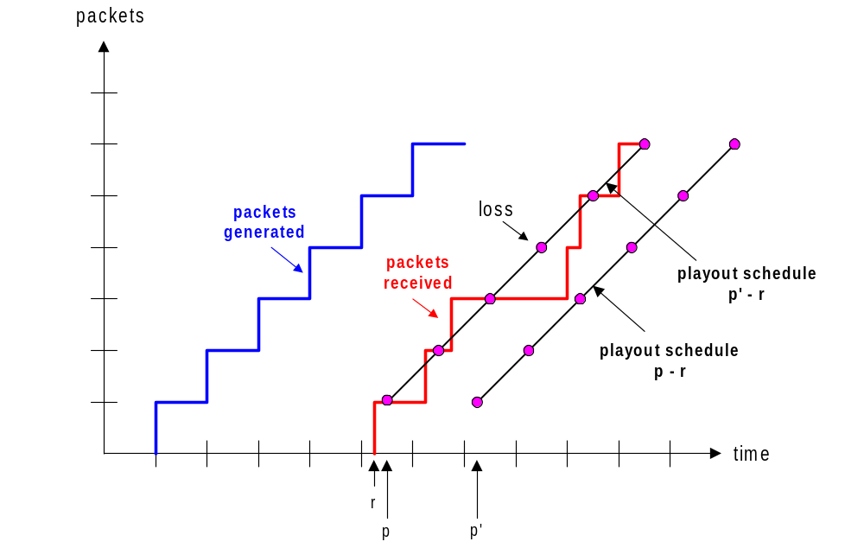
VoIP: fixed playout delay
sender generates packets every 20 msec during talk spurt.
first packet received at time r
first playout schedule: begins at p
second playout schedule: begins at p’
Multmedia Networking
5-<number>

Slide 33
Adaptive playout delay (1)
goal: low playout delay, low late loss rate
approach: adaptive playout delay adjustment:
  estimate network delay, adjust playout delay at beginning of each talk spurt
  silent periods compressed and elongated
  chunks still played out every 20 msec during talk spurt
adaptively estimate packet delay: (EWMA - exponentially weighted moving average, recall TCP RTT estimate):
d_{i} = (1−α)d_{i-1} + α (r_{i} – t_{i})
delay estimate after ith packet
small constant, e.g. 0.1
time received -
time sent (timestamp)
measured delay of ith packet
Multmedia Networking
7-<number>

Slide 34
Adaptive playout delay (2)
also useful to estimate average deviation of delay, v_{i} :
v_{i} = (1−β)v_{i-1} + β |r_{i} – t_{i} – d_{i}|
estimates d_{i}, v_{i} calculated for every received packet, but used only at start of talk spurt
for first packet in talk spurt, playout time is:
remaining packets in talkspurt are played out periodically
playout-time_{i} = t_{i} + d_{i} + Kv_{i}
Multmedia Networking
5-<number>

Slide 35
Adaptive playout delay (3)
Q: How does receiver determine whether packet is first in a talkspurt?
if no loss, receiver looks at successive timestamps
  difference of successive stamps > 20 msec -->talk spurt begins.
with loss possible, receiver must look at both time stamps and sequence numbers
  difference of successive stamps > 20 msec and sequence numbers without gaps --> talk spurt begins.
Multmedia Networking
7-<number>

Slide 36
VoiP: recovery from packet loss (1)
Challenge: recover from packet loss given small tolerable delay between original transmission and playout
each ACK/NAK takes ~ one RTT
alternative: Forward Error Correction (FEC)
  send enough bits to allow recovery without retransmission (recall two-dimensional parity in Ch. 5)
simple FEC
for every group of n chunks, create redundant chunk by exclusive OR-ing n original chunks
send n+1 chunks, increasing bandwidth by factor 1/n
can reconstruct original n chunks if at most one lost chunk from n+1 chunks, with playout delay
Multmedia Networking
7-<number>

Slide 37
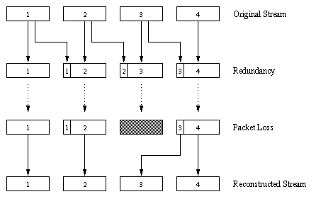
VoiP: recovery from packet loss (2)
another FEC scheme:
“piggyback lower
quality stream”
send lower resolution
audio stream as
redundant information
e.g., nominal
stream PCM at 64 kbps
and redundant stream
GSM at 13 kbps
non-consecutive loss: receiver can conceal loss
generalization: can also append (n-1)st and (n-2)nd low-bit rate
chunk
Multmedia Networking
7-<number>

Slide 38
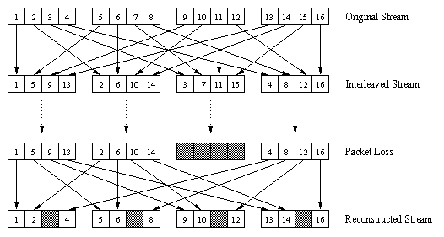
VoiP: recovery from packet loss (3)
interleaving to conceal loss:
audio chunks divided into smaller units, e.g. four 5 msec units per 20 msec audio chunk
packet contains small units from different chunks
if packet lost, still have most of every original chunk
no redundancy overhead, but increases playout delay
Multmedia Networking
7-<number>

Slide 39



Voice-over-IP: Skype
proprietary application-layer protocol (inferred via reverse engineering)
  encrypted msgs
P2P components:
Skype clients (SC)
Skype
login server
supernode (SN)
  clients: skype peers connect directly to each other for VoIP call
supernode
overlay
network
  super nodes (SN): skype peers with special functions
  overlay network: among SNs to locate SCs
  login server
Application Layer
2-<number>

Slide 40

P2P voice-over-IP: skype
skype client operation:
1. joins skype network by contacting SN (IP address cached) using TCP
Skype
login server
2. logs-in (usename, password) to centralized skype login server
3. obtains IP address for callee from SN, SN overlay
  or client buddy list
4. initiate call directly to callee
Application Layer
2-<number>

Slide 41

Skype: peers as relays
problem: both Alice, Bob are behind “NATs”
  NAT prevents outside peer from initiating connection to insider peer
  inside peer can initiate connection to outside
relay solution: Alice, Bob maintain open connection
to their SNs
  Alice signals her SN to connect to Bob
  Alice’s SN connects to Bob’s SN
  Bob’s SN connects to Bob over open connection Bob initially initiated to his SN
Application Layer
2-<number>

Slide 42
Multimedia networking: outline
7.1 multimedia networking applications
7.2 streaming stored video
7.3 voice-over-IP
7.4 protocols for real-time conversational applications: RTP, SIP
7.5 network support for multimedia
Multmedia Networking
7-<number>

Slide 43
Real-Time Protocol (RTP)
RTP specifies packet structure for packets carrying audio, video data
RFC 3550
RTP packet provides
  payload type identification
  packet sequence numbering
  time stamping
RTP runs in end systems
RTP packets encapsulated in UDP segments
interoperability: if two VoIP applications run RTP, they may be able to work together
Multmedia Networking
7-<number>

Slide 44
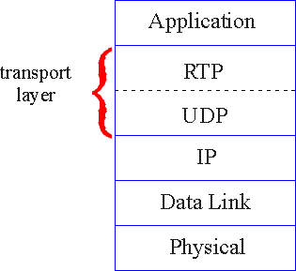
RTP runs on top of UDP
RTP libraries provide transport-layer interface
that extends UDP:
  port numbers, IP addresses
  payload type identification
  packet sequence numbering
  time-stamping
Multmedia Networking
5-<number>

Slide 45
RTP example
example: sending 64 kbps PCM-encoded voice over RTP
application collects encoded data in chunks, e.g., every 20 msec = 160 bytes in a chunk
audio chunk + RTP header form RTP packet, which is encapsulated in UDP segment
RTP header indicates type of audio encoding in each packet
  sender can change encoding during conference
RTP header also contains sequence numbers, timestamps
Multmedia Networking
7-<number>

Slide 46
RTP and QoS
RTP does not provide any mechanism to ensure timely data delivery or other QoS guarantees
RTP encapsulation only seen at end systems (not by intermediate routers)
  routers provide best-effort service, making no special effort to ensure that RTP packets arrive at destination in timely matter
Multmedia Networking
7-<number>

Slide 47
RTP header
payload type
sequence number type
time stamp
Synchronization
Source ID
Miscellaneous fields
payload type (7 bits): indicates type of encoding currently being
used. If sender changes encoding during call, sender
informs receiver via payload type field
  Payload type 0: PCM mu-law, 64 kbps
  Payload type 3: GSM, 13 kbps
  Payload type 7: LPC, 2.4 kbps
  Payload type 26: Motion JPEG
  Payload type 31: H.261
  Payload type 33: MPEG2 video
sequence # (16 bits): increment by one for each RTP packet sent
  detect packet loss, restore packet sequence
Multmedia Networking
5-<number>

Slide 48
RTP header
payload type
sequence number type
time stamp
Synchronization
Source ID
Miscellaneous fields
timestamp field (32 bits long): sampling instant of first byte in this RTP data packet
  for audio, timestamp clock increments by one for each sampling period (e.g., each 125 usecs for 8 KHz sampling clock)
  if application generates chunks of 160 encoded samples, timestamp increases by 160 for each RTP packet when source is active. Timestamp clock continues to increase at constant rate when source is inactive.
SSRC field (32 bits long): identifies source of RTP stream. Each stream in RTP session has distinct SSRC
Multmedia Networking
7-<number>

Slide 49
RTSP/RTP programming assignment
build a server that encapsulates stored video frames into RTP packets
  grab video frame, add RTP headers, create UDP segments, send segments to UDP socket
  include seq numbers and time stamps
  client RTP provided for you
also write client side of RTSP
  issue play/pause commands
  server RTSP provided for you
Multmedia Networking
7-<number>

Slide 50
Real-Time Control Protocol (RTCP)
works in conjunction with RTP
each participant in RTP session periodically sends RTCP control packets to all other participants
each RTCP packet contains sender and/or receiver reports
  report statistics useful to application: # packets sent, # packets lost, interarrival jitter
feedback used to control performance
  sender may modify its transmissions based on feedback
Multmedia Networking
7-<number>

Slide 51
RTCP: multiple multicast senders
sender
RTP
RTCP
RTCP
RTCP
receivers
each RTP session: typically a single multicast address; all RTP /RTCP packets belonging to session use multicast address
RTP, RTCP packets distinguished from each other via distinct port numbers
to limit traffic, each participant reduces RTCP traffic as number of conference participants increases
Multmedia Networking
5-<number>

Slide 52
RTCP: packet types
receiver report packets:
fraction of packets lost, last sequence number, average interarrival jitter
sender report packets:
SSRC of RTP stream, current time, number of packets sent, number of bytes sent
source description packets:
e-mail address of sender, sender's name, SSRC of associated RTP stream
provide mapping between the SSRC and the user/host name
Multmedia Networking
7-<number>

Slide 53
RTCP: stream synchronization
RTCP can synchronize different media streams within a RTP session
e.g., videoconferencing app: each sender generates one RTP stream for video, one for audio.
timestamps in RTP packets tied to the video, audio sampling clocks
  not tied to wall-clock time
each RTCP sender-report packet contains (for most recently generated packet in associated RTP stream):
  timestamp of RTP packet
  wall-clock time for when packet was created
receivers uses association to synchronize playout of audio, video
Multmedia Networking
7-<number>

Slide 54
RTCP: bandwidth scaling
RTCP attempts to limit its traffic to 5% of session bandwidth
example : one sender, sending video at 2 Mbps
RTCP attempts to limit RTCP traffic to 100 Kbps
RTCP gives 75% of rate to receivers; remaining 25% to sender
75 kbps is equally shared among receivers:
  with R receivers, each receiver gets to send RTCP traffic at 75/R kbps.
sender gets to send RTCP traffic at 25 kbps.
participant determines RTCP packet transmission period by calculating avg RTCP packet size (across entire session) and dividing by allocated rate
Multmedia Networking
7-<number>

Slide 55
SIP: Session Initiation Protocol [RFC 3261]
long-term vision:
all telephone calls, video conference calls take place over Internet
people identified by names or e-mail addresses, rather than by phone numbers
can reach callee (if callee so desires), no matter where callee roams, no matter what IP device callee is currently using
Multmedia Networking
7-<number>

Slide 56
SIP services
SIP provides mechanisms for call setup:
  for caller to let callee know she wants to establish a call
  so caller, callee can agree on media type, encoding
  to end call
determine current IP address of callee:
  maps mnemonic identifier to current IP address
call management:
  add new media streams during call
  change encoding during call
  invite others
  transfer, hold calls
Multmedia Networking
7-<number>

Slide 57
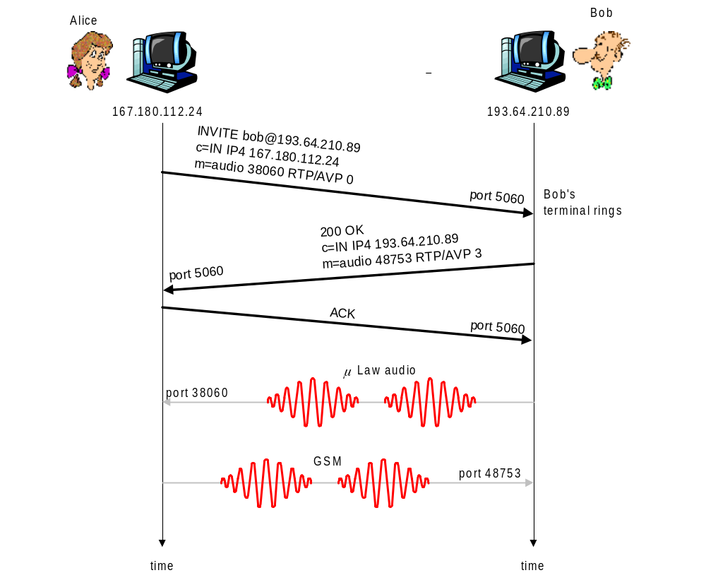
Example: setting up call to known IP address
Alice’s SIP invite message indicates her port number, IP address, encoding she prefers to receive (PCM μlaw)
Bob’s 200 OK message indicates his port number, IP address, preferred encoding (GSM)
SIP messages can be sent over TCP or UDP; here sent over RTP/UDP
default SIP port number is 5060
Multmedia Networking
5-<number>

Slide 58
Setting up a call (more)
codec negotiation:
  suppose Bob doesn’t have PCM μlaw encoder
  Bob will instead reply with 606 Not Acceptable Reply, listing his encoders. Alice can then send new INVITE message, advertising different encoder
rejecting a call
  Bob can reject with replies “busy,” “gone,” “payment required,” “forbidden”
media can be sent over RTP or some other protocol
Multmedia Networking
7-<number>

Slide 59
Example of SIP message
INVITE sip:bob@domain.com SIP/2.0
Via: SIP/2.0/UDP 167.180.112.24
From: sip:alice@hereway.com
To: sip:bob@domain.com
Call-ID: a2e3a@pigeon.hereway.com
Content-Type: application/sdp
Content-Length: 885
c=IN IP4 167.180.112.24
m=audio 38060 RTP/AVP 0
Notes:
HTTP message syntax
sdp = session description protocol
Call-ID is unique for every call
Here we don’t know Bob’s IP address
  intermediate SIP
  servers needed
Alice sends, receives SIP messages using SIP default port 506
Alice specifies in header that SIP client
sends, receives SIP messages over UDP
Multmedia Networking
7-<number>

Slide 60
Name translation, user location
caller wants to call callee, but only has callee’s name or e-mail address.
need to get IP address of callee’s current host:
  user moves around
  DHCP protocol
  user has different IP devices (PC, smartphone, car device)
result can be based on:
  time of day (work, home)
  caller (don’t want boss to call you at home)
  status of callee (calls sent to voicemail when callee is already talking to someone)
Multmedia Networking
7-<number>

Slide 61
SIP registrar
one function of SIP server: registrar
when Bob starts SIP client, client sends SIP REGISTER message to Bob’s registrar server
register message:
REGISTER sip:domain.com SIP/2.0
Via: SIP/2.0/UDP 193.64.210.89
From: sip:bob@domain.com
To: sip:bob@domain.com
Expires: 3600
Multmedia Networking
7-<number>

Slide 62
SIP proxy
another function of SIP server: proxy
Alice sends invite message to her proxy server
  contains address sip:bob@domain.com
  proxy responsible for routing SIP messages to callee, possibly through multiple proxies
Bob sends response back through same set of SIP proxies
proxy returns Bob’s SIP response message to Alice
  contains Bob’s IP address
SIP proxy analogous to local DNS server plus TCP setup
Multmedia Networking
7-<number>

Slide 63
SIP example: jim@umass.edu calls keith@poly.edu
Poly SIP
registrar
2. UMass proxy forwards request
to Poly registrar server
2
3
3. Poly server returns redirect response,
indicating that it should try keith@eurecom.fr
UMass SIP proxy
4. Umass proxy forwards request
to Eurecom registrar server
Eurecom SIP
registrar
4
7
1. Jim sends INVITE
message to UMass SIP proxy.
6-8. SIP response returned to Jim
5. eurecom registrar forwards INVITE to 197.87.54.21, which is running keith’s SIP client
8
5
6
1
9
128.119.40.186
9. Data flows between clients
197.87.54.21
Multmedia Networking
7-<number>

Slide 64
Comparison with H.323
H.323: another signaling protocol for real-time, interactive multimedia
H.323: complete, vertically integrated suite of protocols for multimedia conferencing: signaling, registration, admission control, transport, codecs
SIP: single component. Works with RTP, but does not mandate it. Can be combined with other protocols, services
H.323 comes from the ITU (telephony)
SIP comes from IETF: borrows much of its concepts from HTTP
  SIP has Web flavor; H.323 has telephony flavor
SIP uses KISS principle: Keep It Simple Stupid
Multmedia Networking
7-<number>

Slide 65
Multimedia networking: outline
7.1 multimedia networking applications
7.2 streaming stored video
7.3 voice-over-IP
7.4 protocols for real-time conversational applications
7.5 network support for multimedia
Multmedia Networking
7-<number>

Slide 66
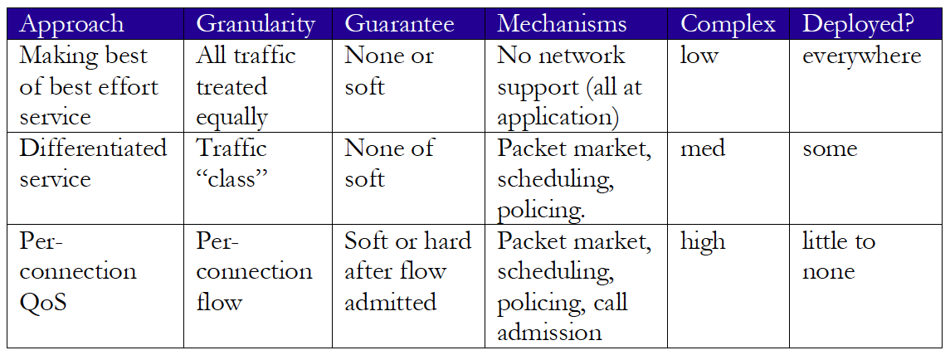
Network support for multimedia
Multmedia Networking
7-<number>

Slide 67
Dimensioning best effort networks
approach: deploy enough link capacity so that congestion doesn’t occur, multimedia traffic flows without delay or loss
  low complexity of network mechanisms (use current “best effort” network)
  high bandwidth costs
challenges:
  network dimensioning: how much bandwidth is “enough?”
  estimating network traffic demand: needed to determine how much bandwidth is “enough” (for that much traffic)
Multmedia Networking
7-<number>

Slide 68

Providing multiple classes of service
thus far: making the best of best effort service
  one-size fits all service model
alternative: multiple classes of service
  partition traffic into classes
  network treats different classes of traffic differently (analogy: VIP service versus regular service)
granularity: differential service among multiple classes, not among individual connections
history: ToS bits
0111
Multmedia Networking
7-<number>

Slide 69
Multiple classes of service: scenario
H1
H3
R1
R2
H4
H2
R1 output
interface
queue
1.5 Mbps link
Multmedia Networking
7-<number>

Slide 70

Scenario 1: mixed HTTP and VoIP
example: 1Mbps VoIP, HTTP share 1.5 Mbps link.
  HTTP bursts can congest router, cause audio loss
  want to give priority to audio over HTTP
R1
R2
Principle 1
packet marking needed for router to distinguish between different classes; and new router policy to treat packets accordingly
Multmedia Networking
7-<number>

Slide 71
Principles for QOS guarantees (more)
what if applications misbehave (VoIP sends higher than declared rate)
  policing: force source adherence to bandwidth allocations
marking, policing at network edge
1 Mbps
phone
R1
R2
1.5 Mbps link
packet marking and policing
Principle 2
provide protection (isolation) for one class from others
Multmedia Networking
7-<number>

Slide 72
Principles for QOS guarantees (more)
allocating fixed (non-sharable) bandwidth to flow: inefficient use of bandwidth if flows doesn’t use its allocation
1 Mbps
phone
1 Mbps logical link
R1
R2
1.5 Mbps link
0.5 Mbps logical link
Principle 3
while providing isolation, it is desirable to use
resources as efficiently as possible
Multmedia Networking
7-<number>

Slide 73
Scheduling and policing mechanisms
scheduling: choose next packet to send on link
FIFO (first in first out) scheduling: send in order of arrival to queue
  real-world example?
  discard policy: if packet arrives to full queue: who to discard?
    tail drop: drop arriving packet
    priority: drop/remove on priority basis
    random: drop/remove randomly
packet
arrivals
packet
departures
queue
(waiting area)
link
(server)
Multmedia Networking
7-<number>

Slide 74

Scheduling policies: priority
priority scheduling: send highest priority queued packet
multiple classes, with different priorities
  class may depend on marking or other header info, e.g. IP source/dest, port numbers, etc.
  real world example?
high priority queue
(waiting area)
arrivals
departures
classify
link
(server)
low priority queue
(waiting area)
2
1
3
4
5
arrivals
packet in service
1
3
2
4
5
departures
1
3
2
4
5
Multmedia Networking
7-<number>

Slide 75
Scheduling policies: still more
Round Robin (RR) scheduling:
multiple classes
cyclically scan class queues, sending one complete packet from each class (if available)
real world example?
2
1
3
4
5
arrivals
packet in service
1
3
2
4
5
departures
1
3
3
4
5
Multmedia Networking
7-<number>

Slide 76
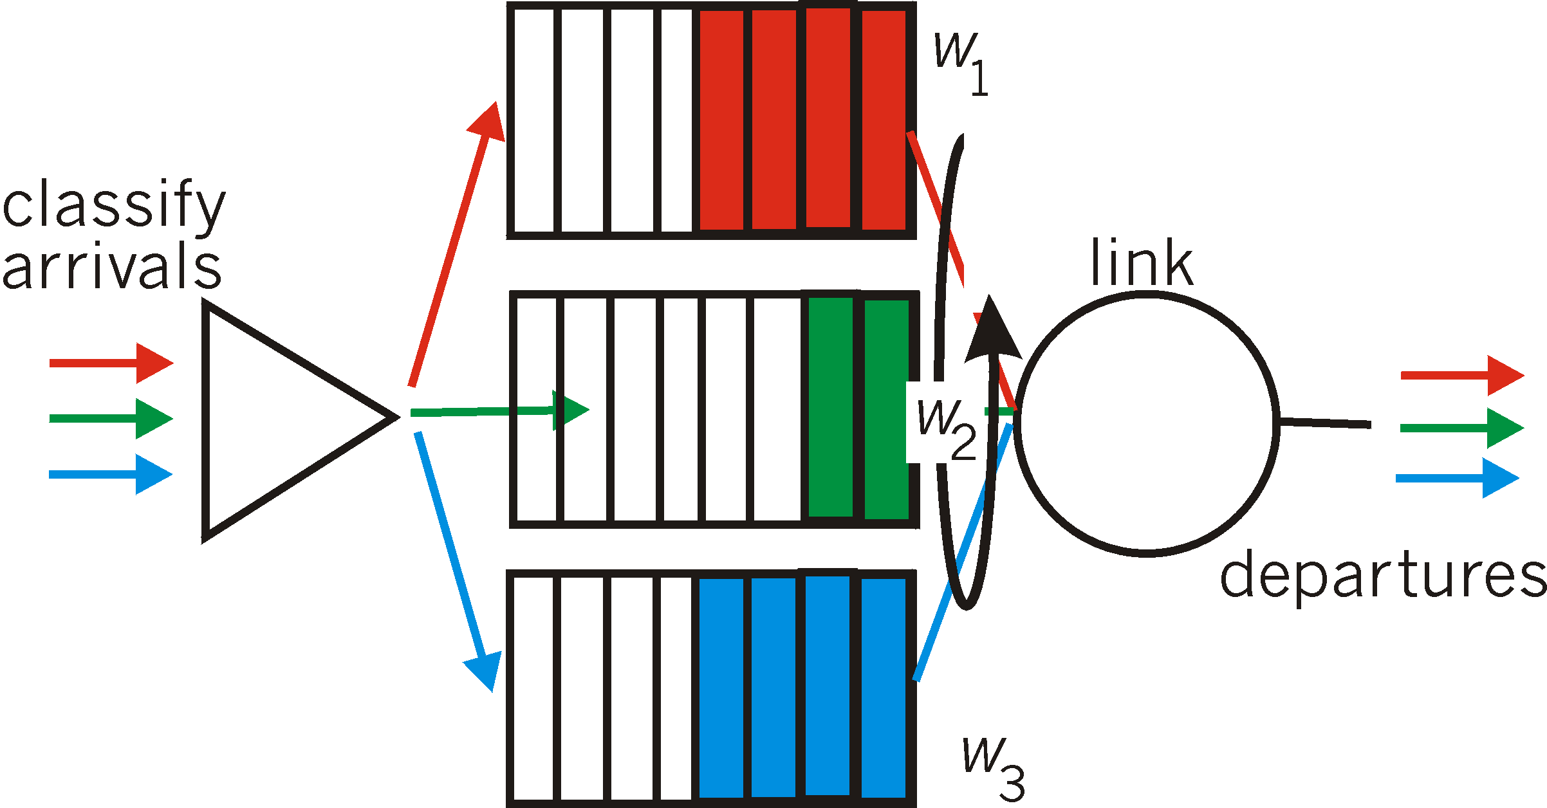
Scheduling policies: still more
Weighted Fair Queuing (WFQ):
generalized Round Robin
each class gets weighted amount of service in each cycle
real-world example?
Multmedia Networking
7-<number>

Slide 77
Policing mechanisms
goal: limit traffic to not exceed declared parameters
Three common-used criteria:
(long term) average rate: how many pkts can be sent per unit time (in the long run)
  crucial question: what is the interval length: 100 packets per sec or 6000 packets per min have same average!
peak rate: e.g., 6000 pkts per min (ppm) avg.; 1500 ppm peak rate
(max.) burst size: max number of pkts sent consecutively (with no intervening idle)
Multmedia Networking
7-<number>

Slide 78
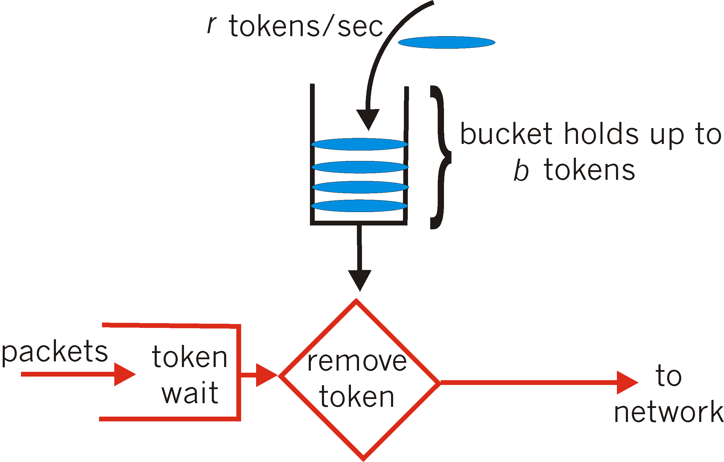
Policing mechanisms: implementation
token bucket: limit input to specified burst size and average rate
bucket can hold b tokens
tokens generated at rate r token/sec unless bucket full
over interval of length t: number of packets admitted less than or equal to (r t + b)
Multmedia Networking
7-<number>

Slide 79
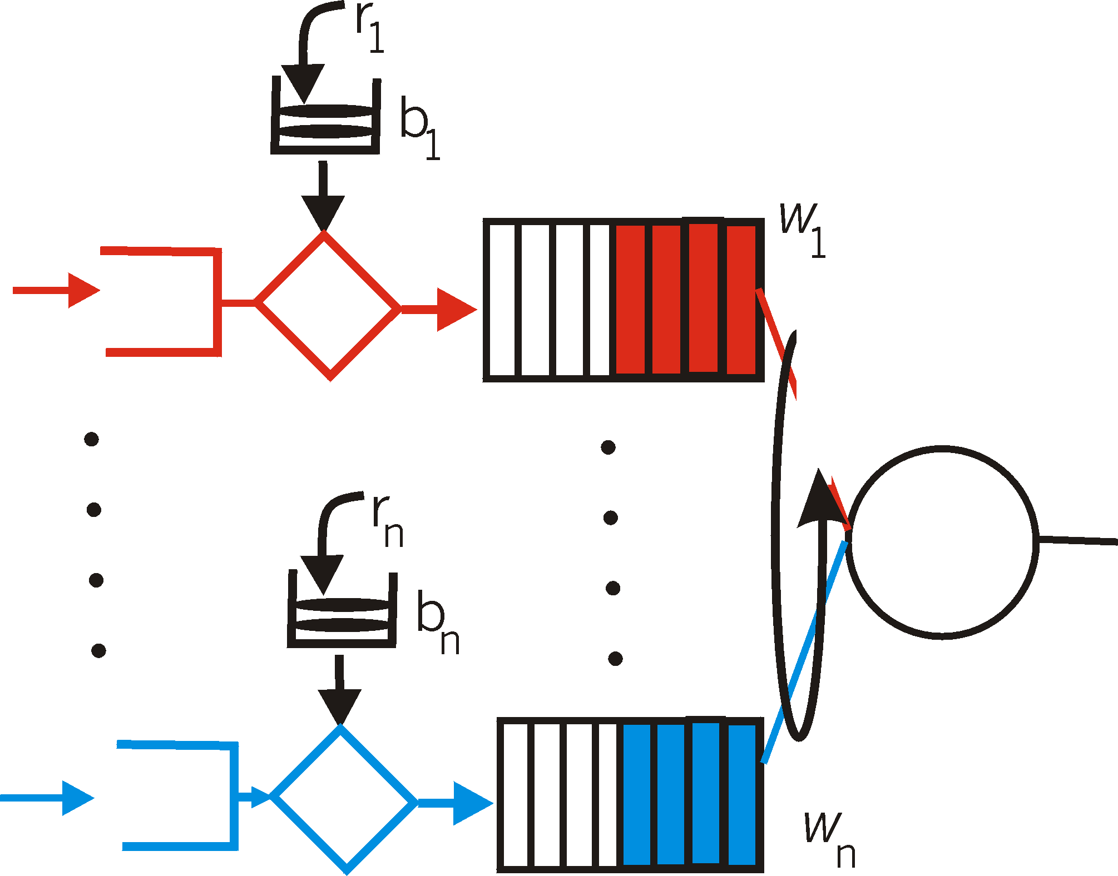
Policing and QoS guarantees
token bucket, WFQ combine to provide guaranteed upper bound on delay, i.e., QoS guarantee!
arriving
traffic
token rate, r
bucket size, b
per-flow
rate, R
WFQ
D = b/R
arriving
traffic
max
Multmedia Networking
7-<number>

Slide 80
Differentiated services
want “qualitative” service classes
  “behaves like a wire”
  relative service distinction: Platinum, Gold, Silver
scalability: simple functions in network core, relatively complex functions at edge routers (or hosts)
  signaling, maintaining per-flow router state difficult with large number of flows
don’t define define service classes, provide functional components to build service classes
Multmedia Networking
7-<number>

Slide 81
Diffserv architecture
marking
r
edge router:
per-flow traffic management
marks packets as in-profile and out-profile
b
scheduling
.
.
.
core router:
per class traffic management
buffering and scheduling based on marking at edge
preference given to in-profile packets over out-of-profile packets
Multmedia Networking
7-<number>

Slide 82
Edge-router packet marking
profile: pre-negotiated rate r, bucket size b
packet marking at edge based on per-flow profile
rate r
b
user packets
possible use of marking:
class-based marking: packets of different classes marked differently
intra-class marking: conforming portion of flow marked differently than non-conforming one
Multmedia Networking
5-<number>

Slide 83
Diffserv packet marking: details
packet is marked in the Type of Service (TOS) in IPv4, and Traffic Class in IPv6
6 bits used for Differentiated Service Code Point (DSCP)
  determine PHB that the packet will receive
  2 bits currently unused
DSCP
unused
Multmedia Networking
7-<number>

Slide 84
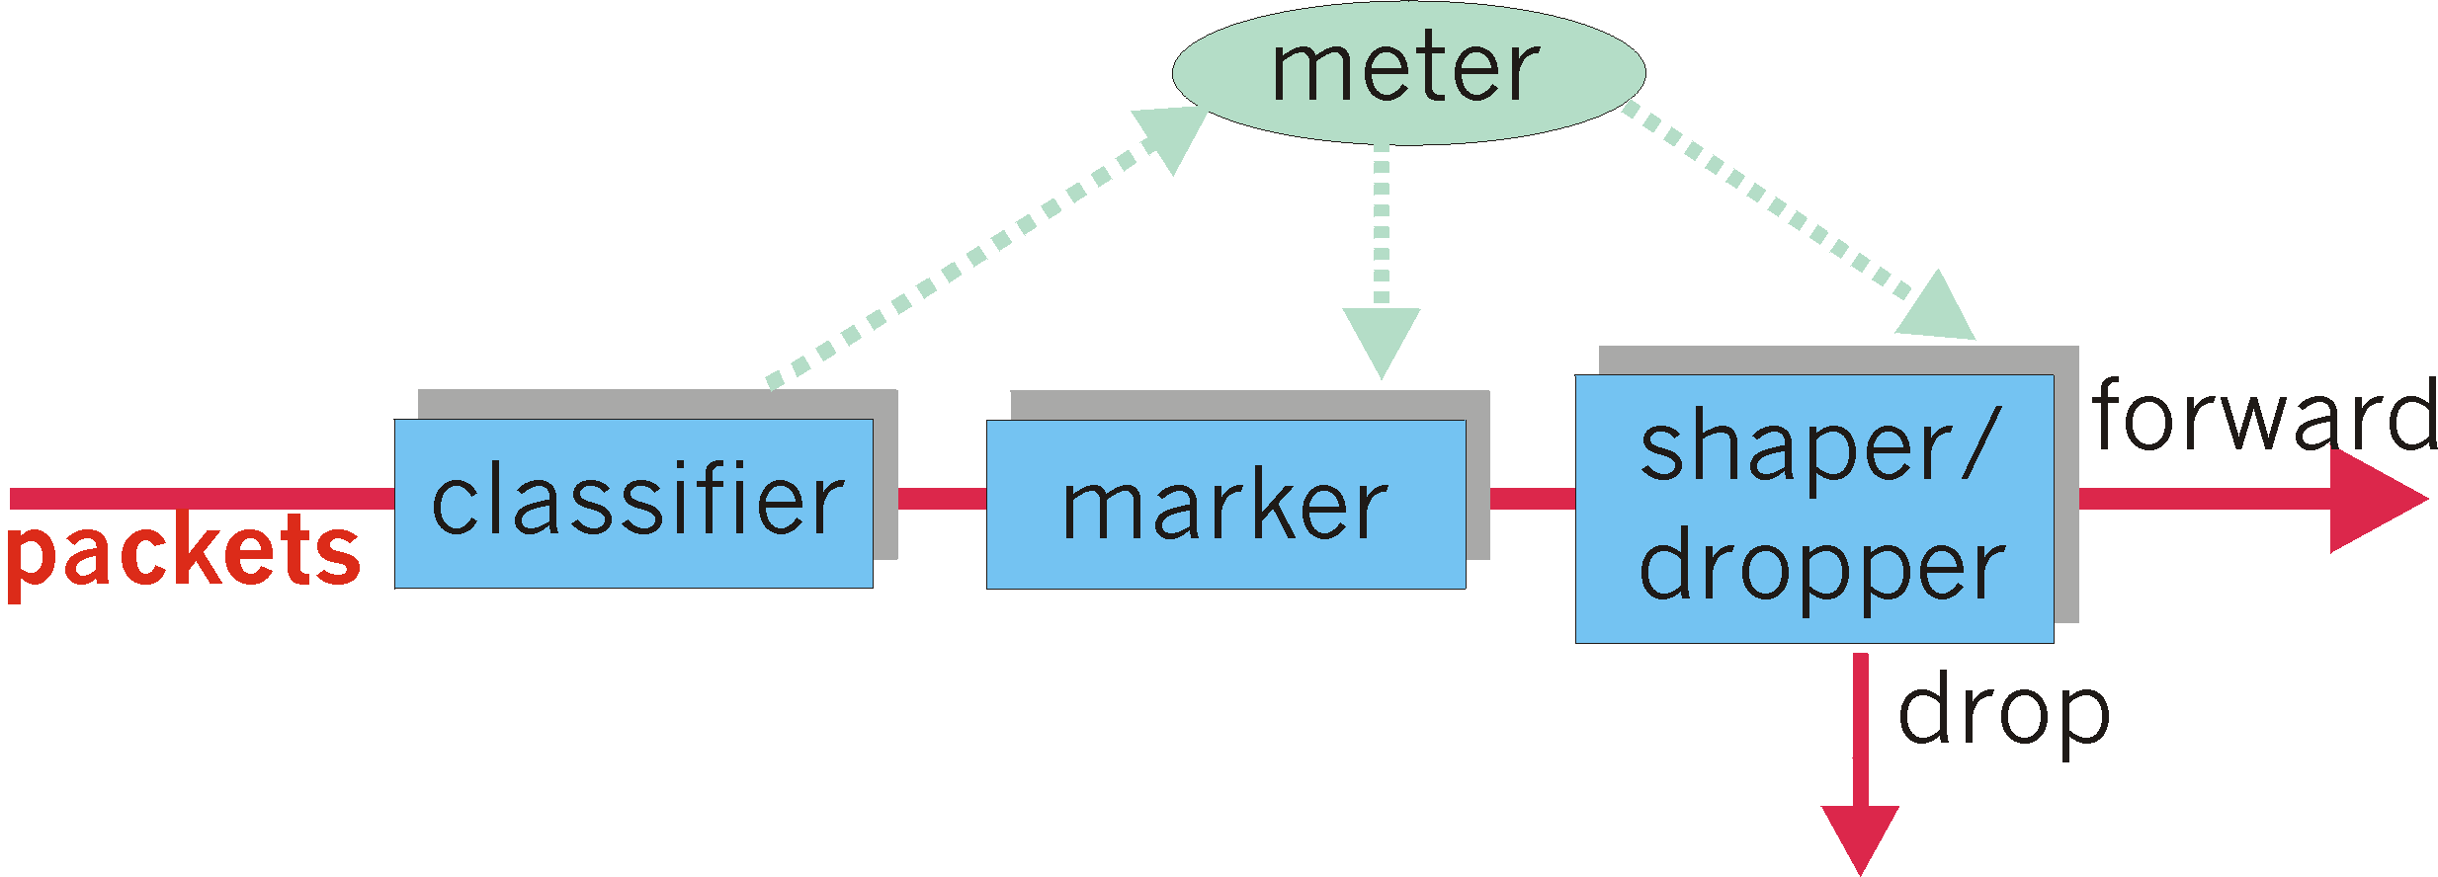
Classification, conditioning
may be desirable to limit traffic injection rate of some class:
user declares traffic profile (e.g., rate, burst size)
traffic metered, shaped if non-conforming
Multmedia Networking
7-<number>

Slide 85
Forwarding Per-hop Behavior (PHB)
PHB result in a different observable (measurable) forwarding performance behavior
PHB does not specify what mechanisms to use to ensure required PHB performance behavior
examples:
  class A gets x% of outgoing link bandwidth over time intervals of a specified length
  class A packets leave first before packets from class B
Multmedia Networking
7-<number>

Slide 86
Forwarding PHB
PHBs proposed:
expedited forwarding: pkt departure rate of a class equals or exceeds specified rate
  logical link with a minimum guaranteed rate
assured forwarding: 4 classes of traffic
  each guaranteed minimum amount of bandwidth
  each with three drop preference partitions
Multmedia Networking
7-<number>

Slide 87
Per-connection QOS guarantees
basic fact of life: can not support traffic demands beyond link capacity
1 Mbps
phone
R1
R2
1 Mbps
phone
1.5 Mbps link
Principle 4
call admission: flow declares its needs, network may
block call (e.g., busy signal) if it cannot meet needs
Multmedia Networking
7-<number>

Slide 88
QoS guarantee scenario
resource reservation
  call setup, signaling (RSVP)
  traffic, QoS declaration
  per-element admission control
request/
reply
  QoS-sensitive scheduling (e.g., WFQ)
Multmedia Networking
7-<number>

Slide 89
Multimedia networking: outline
7.1 multimedia networking applications
7.2 streaming stored video
7.3 voice-over-IP
7.4 protocols for real-time conversational applications
7.5 network support for multimedia
Multmedia Networking
7-<number>

